Slide 1

Dept. of B.Tech CSE (AI & ML)
Bug Detection and Fixing
Presented BY:
PRITAM CHAKRABORTTY
Student Code : BWU/BTA/22/388
Programme: B.TECH IN CSE-AIML G
Course name: Industrial Training
Semester : VII
Course Code: PROJ-CSM782
Brainware University

Slide 2
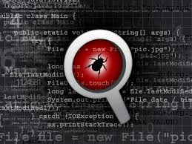
Dept. of B.Tech CSE (AI & ML)
Introduction
Software bugs cause crashes, errors, and security risks.
Manual debugging is time-consuming and difficult.
AI can help detect and fix bugs automatically.
This project uses AI to analyze code and provide fixes.

Slide 3
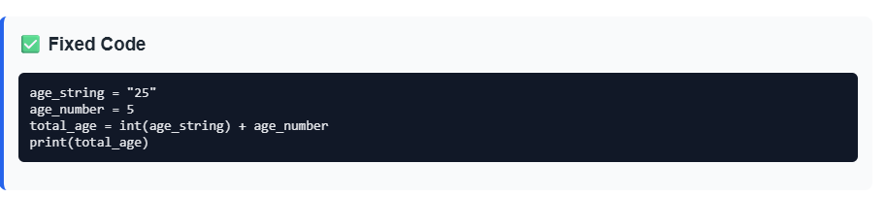
Dept. of B.Tech CSE (AI & ML)
Objective of the Project
Detect programming errors automatically.
Explain errors clearly with line numbers.
Generate a fully corrected version of code.
Support multiple programming languages.
Help beginners and developers save time.

Slide 4
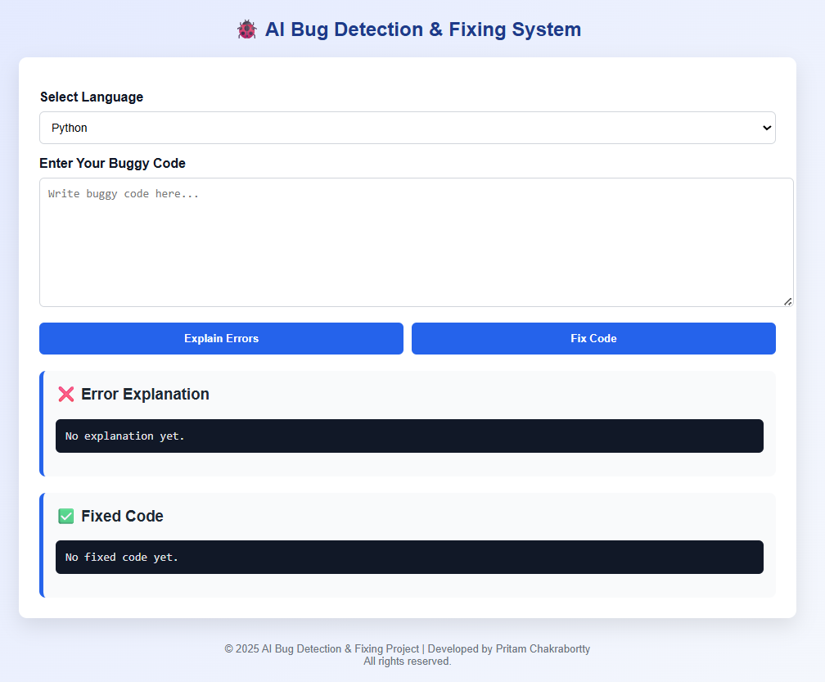
Dept. of B.Tech CSE (AI & ML)
System Overview
User first selects the programming language.
User enters the buggy source code in the input area.
“Explain Error” button analyzes the code.
Errors are explained line-by-line with exact line numbers.
“Fix Code” button generates the fully corrected code.
User can copy and run the corrected code directly.

Slide 5
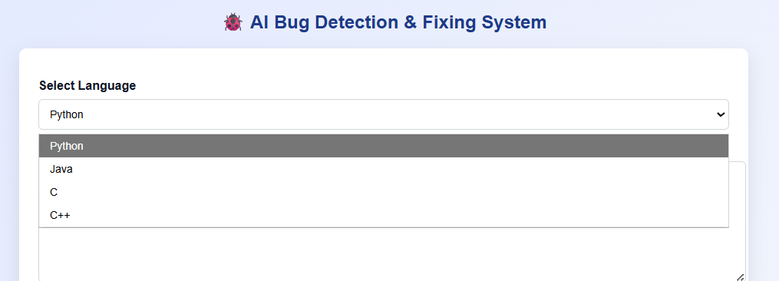
Dept. of B.Tech CSE (AI & ML)
User Interface
Clean and modern UI design
Separate sections for:
Error explanation
Fixed code
Buttons for:
Explain Errors
Fix Code
Copy-ready output

Slide 6
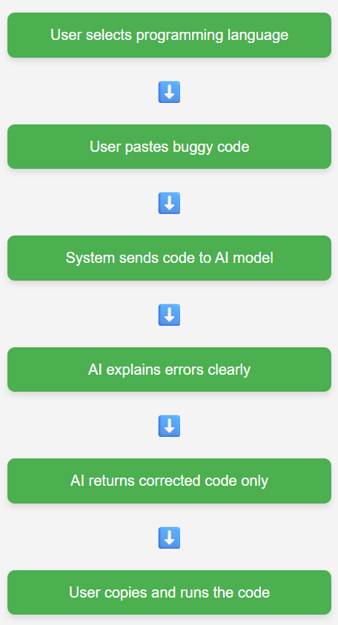
Dept. of B.Tech CSE (AI & ML)
Working Methodology
User selects programming language
User pastes buggy code
System sends code to AI model
AI explains errors clearly
AI returns corrected code only
User copies and runs the code

Slide 7
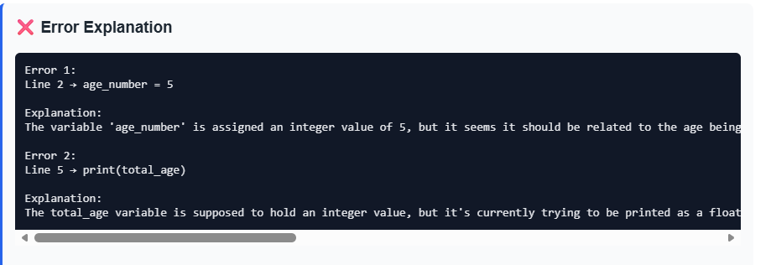
Dept. of B.Tech CSE (AI & ML)
Features of the System
Line-wise error explanation.
Simple and clear error messages.
User-friendly interface.
Supports Python, Java, C, and C++
Fully corrected code output,

Slide 8
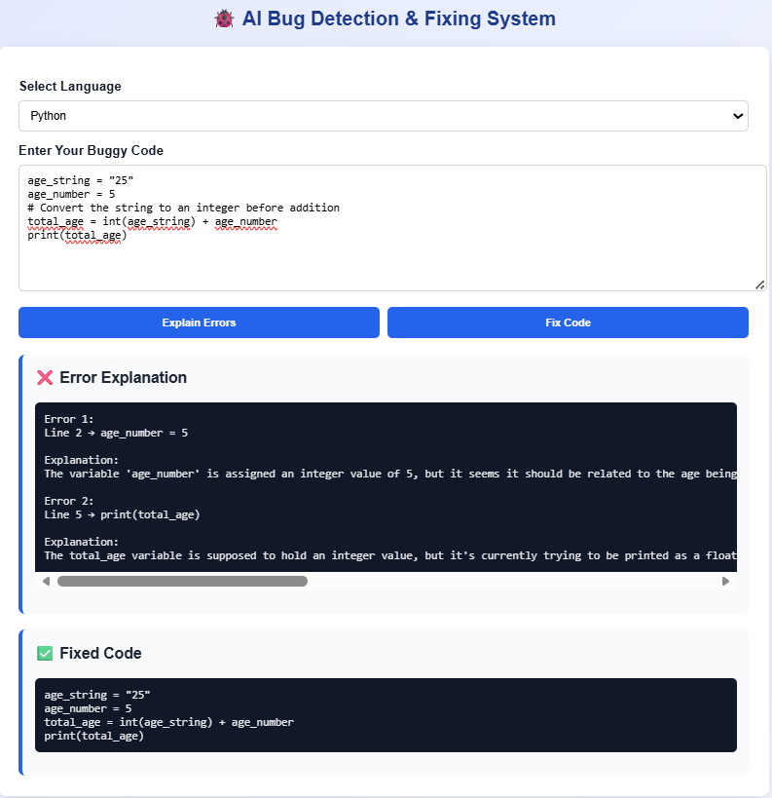
Dept. of B.Tech CSE (AI & ML)
Visualization
🔗 Project Link:AI Bug Detection & Fixing System – Live Demo
🔗 GitHub Repository: Intel Bug Detection & Fixing Project

Slide 9
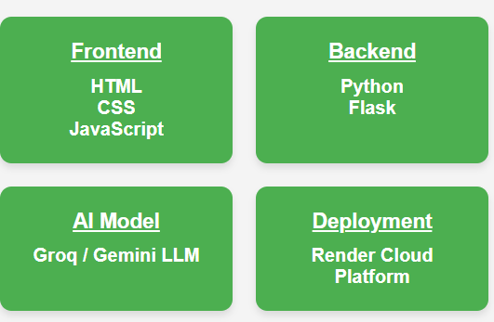
Dept. of B.Tech CSE (AI & ML)
Technologies Used
Frontend:
HTML
CSS
JavaScript
Backend:
Python
Flask
AI Model:
Groq / Gemini Large Language Model
Deployment:
Render Cloud Platform

Slide 10
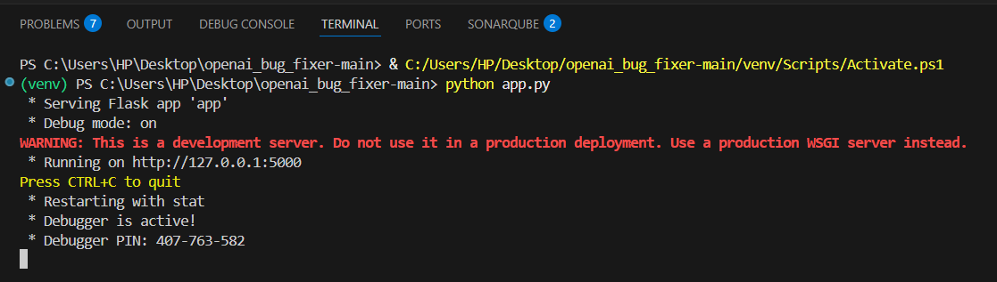
Installation & Setup
Dept. of B.Tech CSE (AI & ML)
1. Clone the repository
git clone <https://github.com/Pritam-Chakrabortty/openai_bug_fixer-main>
Create a virtual environment:
Activate the virtual environment:
  Windows:
  Linux/Mac:
Install project dependencies:
Run the application:
python -m venv venv
venv\Scripts\activate
source venv/bin/activate
pip install -r requirements.txt
python app.py

Slide 11

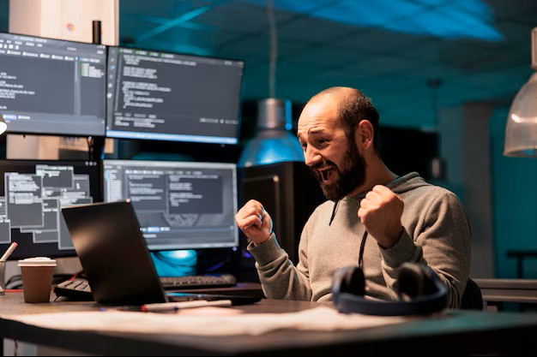
Dept. of B.Tech CSE (AI & ML)
Advantages & Applications
Applications:
Student learning
Code review assistance
Interview preparation
Software development support
Advantages:
Saves debugging time
Easy for beginners
Reduces manual effort

Slide 12
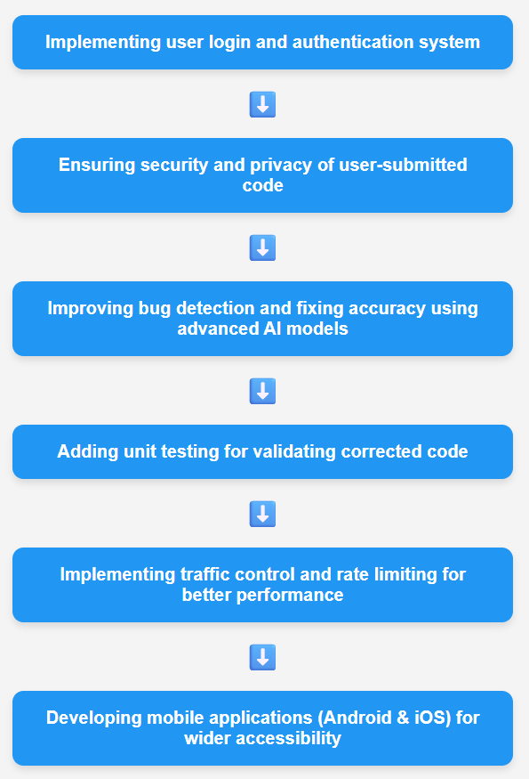
Dept. of B.Tech CSE (AI & ML)
Future Scope

Slide 13
Conclusion
Dept. of B.Tech CSE (AI & ML)
Future enhancements can further improve accuracy, security, and usability
Successfully developed an AI-powered bug detection and fixing system
Users can select programming language, enter buggy code, and analyze errors
System provides line-by-line error explanations
Generates fully corrected, ready-to-run code
Reduces manual debugging time and effort
Demonstrates practical use of AI models with Flask web applications
Project is scalable and extendable for real-world use
Acknowledgement
REFERENCES & Acknowledgement
This project was developed under the guidance and approval of our Head of Department,
Dr. Shivnath Ghosh.
I sincerely thank my project mentor, Mr. Bablu Sir, for his continuous support, guidance, and valuable suggestions throughout the development of this project.
AI language models were used for bug detection and code fixing.
Technologies referred: Python, Flask, Groq API, HTML, CSS, JavaScript.
Additional references include official documentation, GitHub repositories, and technical blogs.

Slide 14


Slide 15


